Slide 1
Compressor and other system component technology for R1234yf systems
Presented by Mark Mitchell Director – Global Marketing and Technical Support Unicla International Limited

Slide 2
Technical and engineering steps to R1234yf
Following regulatory pressure, all global MVAC and vehicle manufacturer commenced the Co-operative Research Project ( CRP) for an alternative to R134a.
CRP was engineering and environmentally focussed – administered by SAE International
After extensive tests of hundreds of alternatives, R1234yf was the clear winner

Slide 3
Technical and engineering steps to R1234yf
As a compressor manufacturer, the first challenge is to select and validate the lubricant – minimum 2000 hours of testing
Next is to check and validate the functionality of the refrigerant and how it operates in the compressor and systems where the compressor is used.
Compliance to all necessary manufacturing and safety standards

Slide 4
Lubricant
Must meet ASHRAE standards for refrigerant suitability.
Current generation PAG and POE lubricants used in R134a found to have unacceptable chemical stability, and thermal and hydrolytic properties when used with R1234yf.
Manufactures were quick to develop suitable double end capped PAGs.
Di-capped PAG lubricants appear to be the major choice by OEMs for R1234yf, CO2 and electric drive MAC systems.

Slide 5
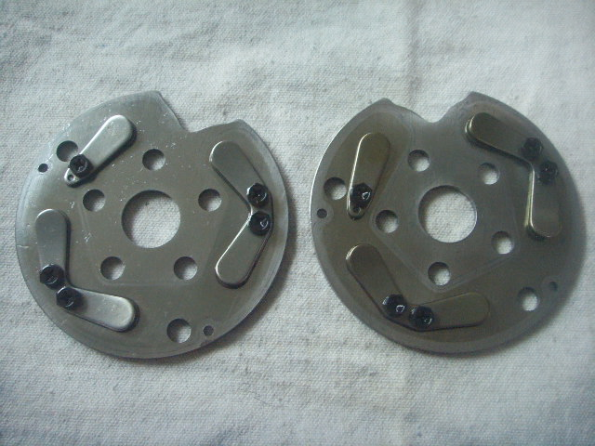
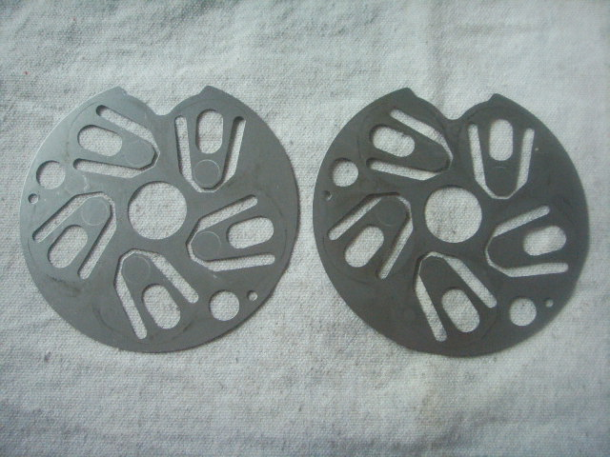
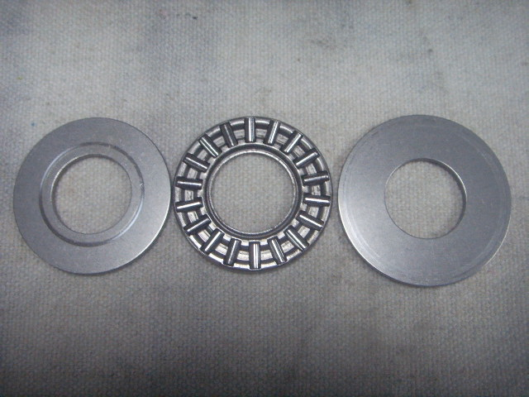
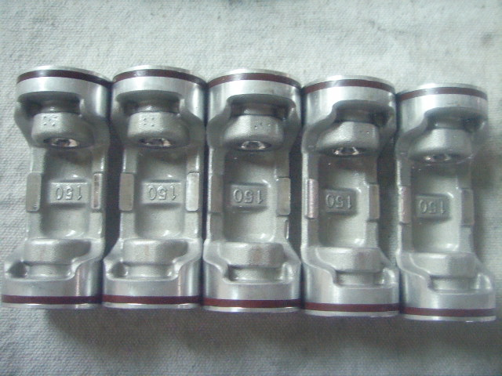
Lubricant
Quality evaluation: Typical test is 2000 hrs at 500hr intervals
Compressor |  |  |  |  | Condenser |  | Evaporator
r.p.m | Discharge pressure kg/c㎡ | Suction pressure kg/c㎡ | Discharge temp. ℃ | Suction temp. ℃ | Temp. in ℃ | Temp. out ℃ | Temp. in ℃ | Temp. out ℃
800 | 14.0 | 3.3 | 60.1 | 17.5 | 61.1 | 48.8 | 34.2 | 20.6
2,000 | 15.4 | 2.7 | 69.6 | 16.7 | 69.7 | 51.4 | 31.7 | 19.6
3,000 | 13.2 | 1.7 | 87.0 | 14.7 | 87.6 | 50.8 | 27.3 | 7.0
3,500 | 14.0 | 1.8 | 88.4 | 17.4 | 91.1 | 52.5 | 27.4 | 8.9
1,500 | 12.9 | 2.0 | 68.0 | 12.8 | 70.0 | 52.0 | 29.0 | 9.0

Slide 6
Lubricant
Unicla compressors use Shrieve ZEROL HD46 due
to excellent anti-wear and low hygroscopicity

Slide 7
Refrigerant operation
Comparing R1234yf to R134a
0°C
R134a has pressure of 191.2 kpa (27.7 psi)
R1234yf is higher at 215.30 kpa (31.2 psi)
54°C
R134a has pressure of 1354.1 kpa (196.4 psi)
R1234yf is lower at 1322.7 kpa (191.7 psi)

Slide 8
Refrigerant operation
A test was carried out to provide a comparison of performance results from a common system operating on R134a refrigerant as compared against a same system converted to operate with OPTEON R1234yf refrigerant. The test comprised of the following components:
Refrigerant | Dupont - R134a | Dupont – OPTEON R1234yf
Condenser | Kysor EC6 | Kysor EC6
Compressor | Unicla UP150 | Unicla UP150
Expansion valve | Eaton block type 2.0 ton – R134a comp. | Eaton block type 2.0 ton – R134a comp.
Hose | Burgaflex 3090 series | Burgaflex 3090 series
Hose connectors | Burgaclip with R134a service ports | Burgaclip with R1234yf service ports
Evaporator | Carrier EM14 | Carrier EM14
Lubricant | Unidap7 – PAG46 | Shrieve- Zerol HD- PAG46
Power supply | 24 volt | 24 volt

Slide 9
Refrigerant operation
Highlights:
Test condition | Average result over 60 tests
R1234yf system running same refrigerant weight as R134a ( 1.7 kg) and compressor speed of 1500 rpm | Lower discharge pressure 0.4 – 1.0 bar Lower discharge line temperature 2-4K Higher suction pressure 0.17 -0.47 bar Different evaporator superheat range ±1.8K Lower sub cooling 4.5 – 4.8K Lower air TD across evaporator 0.7K

Slide 10
Refrigerant operation
R134a and R1234yf, condenser sub-cooling and evaporator super heat table
Unicla test - 1.7kg refrigerant charge at 1500rpm
Ambient | Refrigerant type | Suction evaporator pressure | Condenser pressure | Suction evaporator temperature | Condenser temperature | Super heat | Sub-cool
25˚C | R134a | 1.92 bar | 10.35 bar | 8.70˚C | 37.10˚C | 8.70˚C | 9.90˚C
25˚C | R134a | 1.97 bar | 12.37 bar | 7.30˚C | 43.30˚C | 6.80˚C | 7.20˚C
25˚C | R134a | 1.94 bar | 12.97 bar | 6.30˚C | 45.20˚C | 6.30˚C | 7.05˚C
35˚C | R134a | 2.84 bar | 15.08 bar | 13.10˚C | 51.60˚C | 5.10˚C | 6.10˚C
35˚C | R134a | 2.85 bar | 17.52 bar | 15.40˚C | 58.30˚C | 7.40˚C | 5.95˚C
35˚C | R134a | 2.87 bar | 19.58 bar | 15.90˚C | 63.50˚C | 7.90˚C | 5.25˚C
25˚C | R1234-yf | 2.39 bar | 10.23 bar | 10.90˚C | 42.60˚C | 6.90˚C | 2.40˚C
25˚C | R1234-yf | 2.17 bar | 11.87 bar | 10.50˚C | 48.00˚C | 8.50˚C | 2.00˚C
25˚C | R1234-yf | 2.35 bar | 12.50 bar | 10.50˚C | 47.70˚C | 6.50˚C | 4.30˚C
35˚C | R1234-yf | 3.01 bar | 13.84 bar | 15.90˚C | 54.10˚C | 6.90˚C | 1.90˚C
35˚C | R1234-yf | 3.00 bar | 15.50 bar | 16.70˚C | 58.80˚C | 7.70˚C | 2.20˚C
35˚C | R1234-yf | 3.09 bar | 16.68 bar | 16.10˚C | 61.80˚C | 6.60˚C | 2.20˚C
Higher on low side
Lower on high side

Slide 11
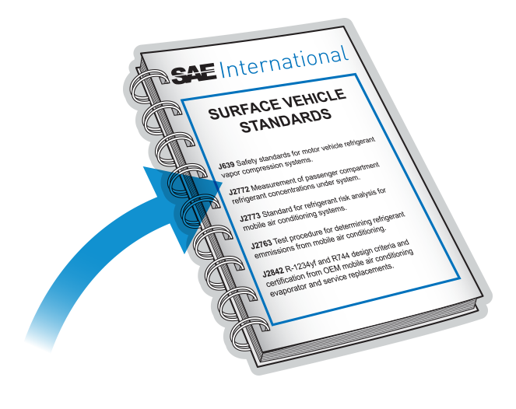
Standards
SAE International always at the forefront of MVAC design and innovation
Work commenced in 2003 for the search of an alternative to R134a
Dupont and Honeywell did the chemistry SAE took the lead on system design, component upgrades and risk assessment at the vehicles' level
Five key standards deal with new low GWP refrigerants R1234yf and R744 (CO2)

Slide 12
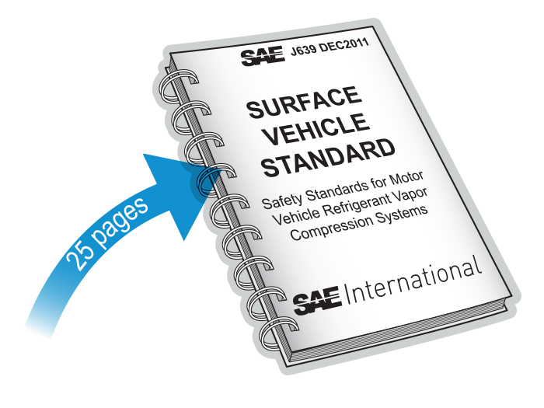
SAE standard J639
References to 48 SAE standards
Refers to refrigerants R134a, R1234yf, R-744
Specifies design of fittings for R12 and R-152a
Passenger cars only (trucks and buses not included)
Prohibits use of any refrigerant rated less than A2L
Provides standards for design, assembly, testing and service to minimise environmental, health and safety impacts

Slide 13
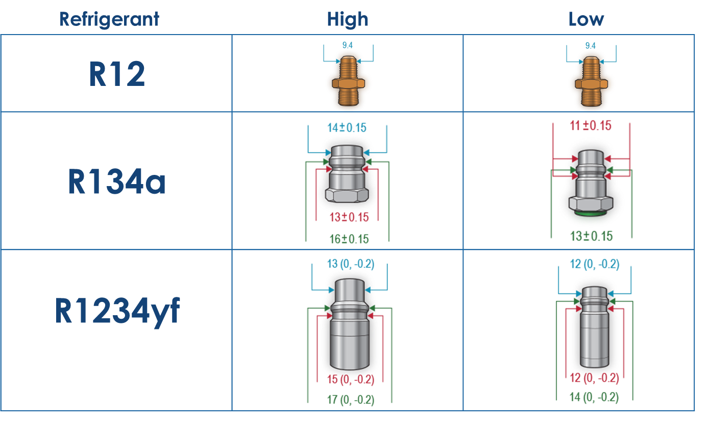
SAE standard J639- Service port fittings

Slide 14
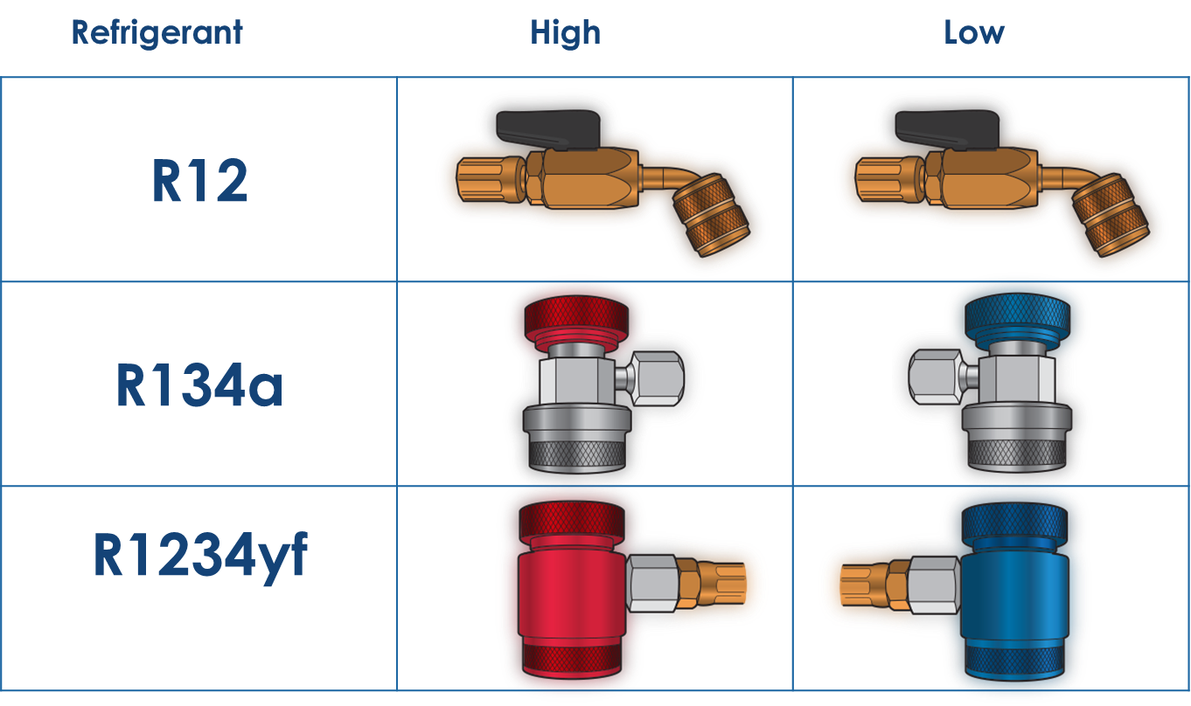
SAE standard J639- Service charge couplings

Slide 15
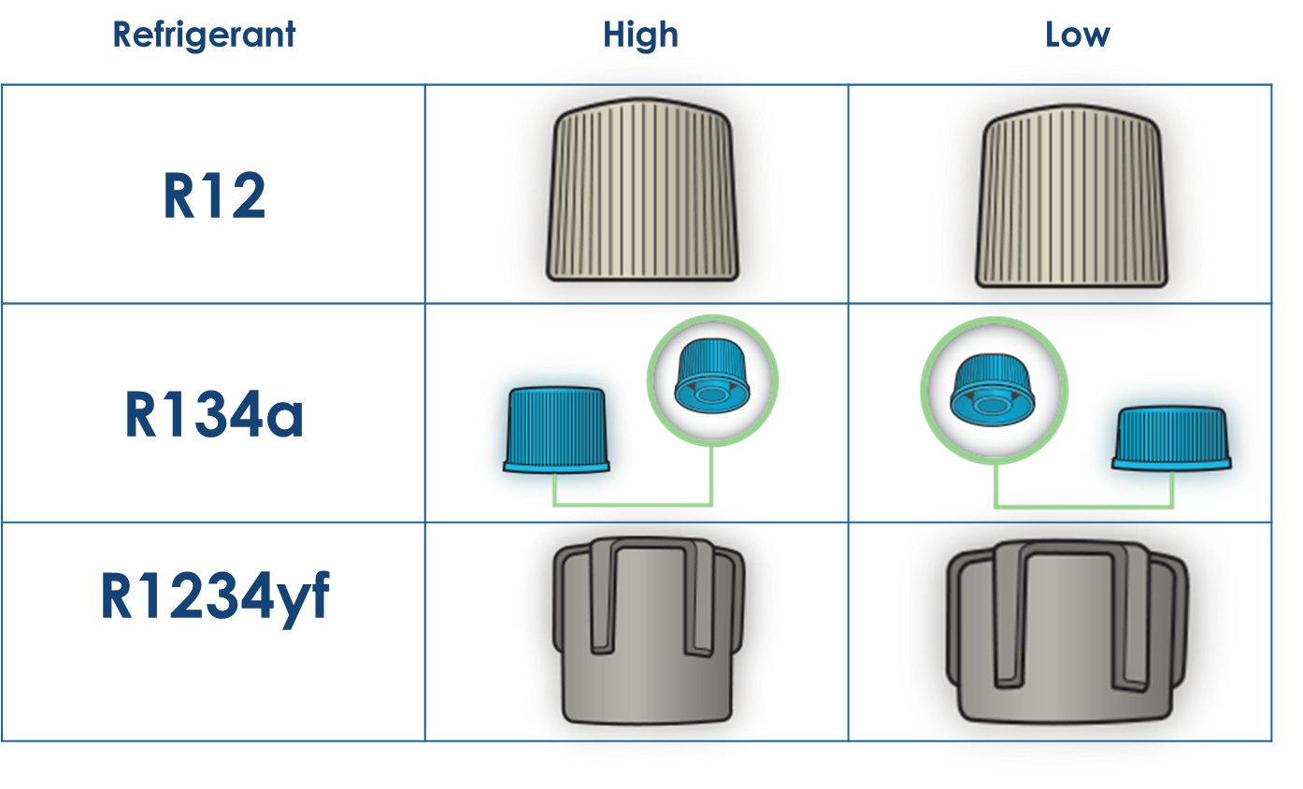
SAE standard J639- Service fitting caps

Slide 16
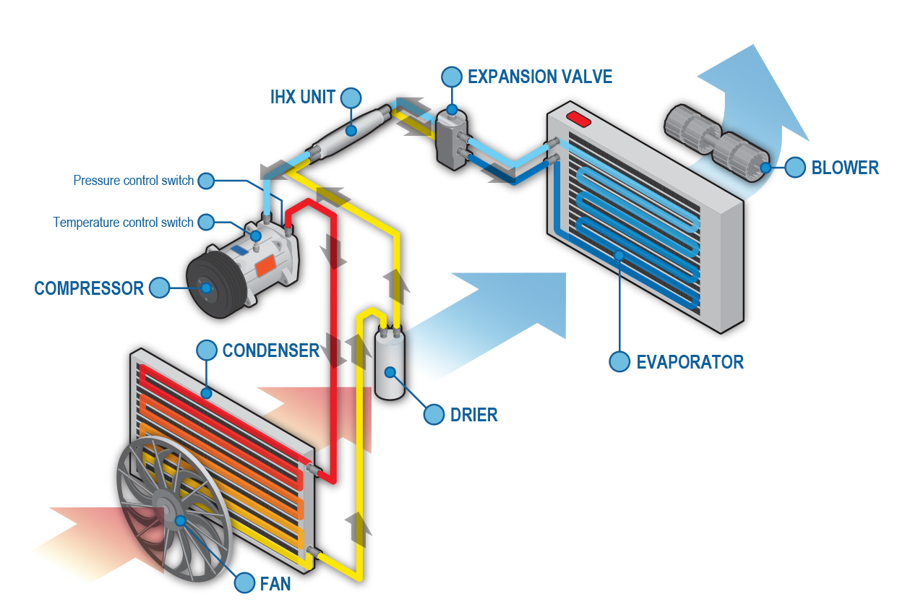
SAE standard J639 - R1234yf maximum working pressure
High side:
must not exceed 4.14 mPa (600 psig) gauge pressure during operation
must not exceed limit of any system component
pressure must be limited by compressor operation before relief valve on burst disc
Low side:
must not exceed 1.46 mPa (according to saturation pressure of R1234yf at 56°C) with system on or off
high pressure vapour
high pressure liquid
low pressure liquid
low pressure vapour

Slide 17
SAE standard J639 - R1234yf maximum system burst pressure
High side:
new components must not be less than two times the working pressure of 8.24 mPA (1200 psig)
Low side:
new components must not be less than two times allowable pressure with system on or off – 2.92 (423psig) mPa
high pressure vapour
high pressure liquid
low pressure liquid
low pressure vapour

Slide 18
SAE standard J639 - R1234yf maximum working temperature
High side:
discharge outlet at compressor and line must not exceed 150°C during continuous operation
discharge outlet must not exceed 160°C during intermittent (5 minute intervals) during operation
Low side:
must not exceed 56°C with system on or off
high pressure vapour
high pressure liquid
low pressure liquid
low pressure vapour

Slide 19
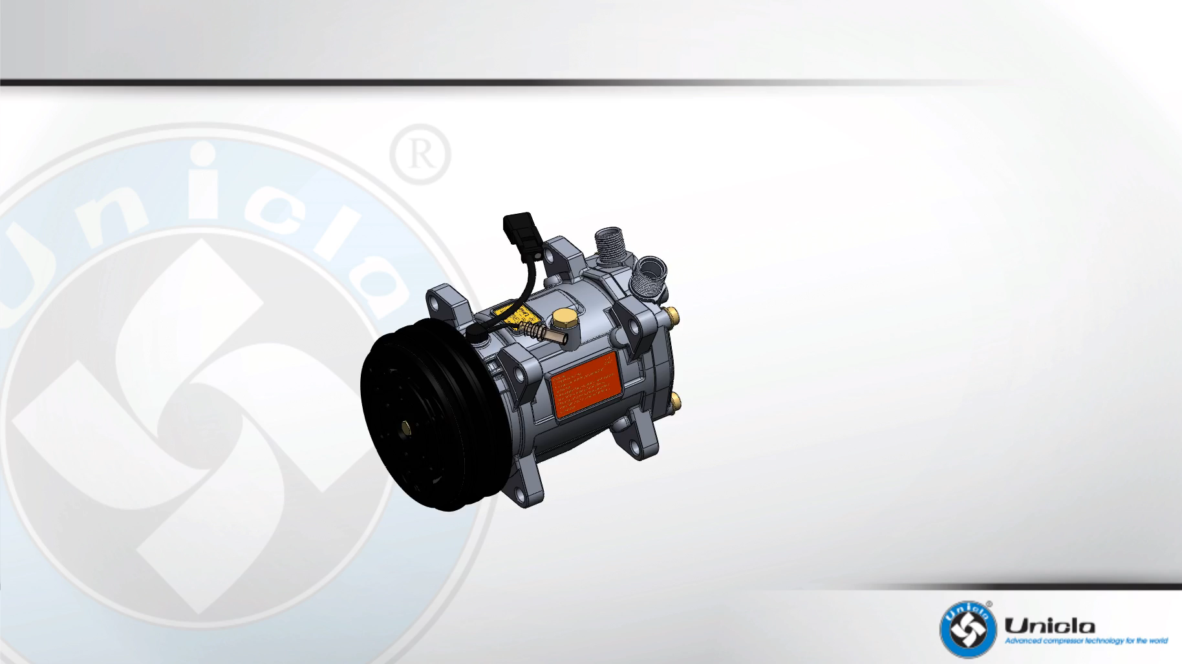
SAE standard J639 - compressor design and requirements

Slide 20
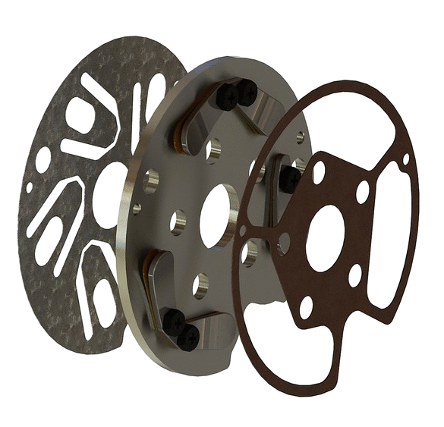

R1234yf maximum burst pressure of
compressor and adjacent cavities
SAE standard J639 -
Suction valve plate
Gasket

Slide 21
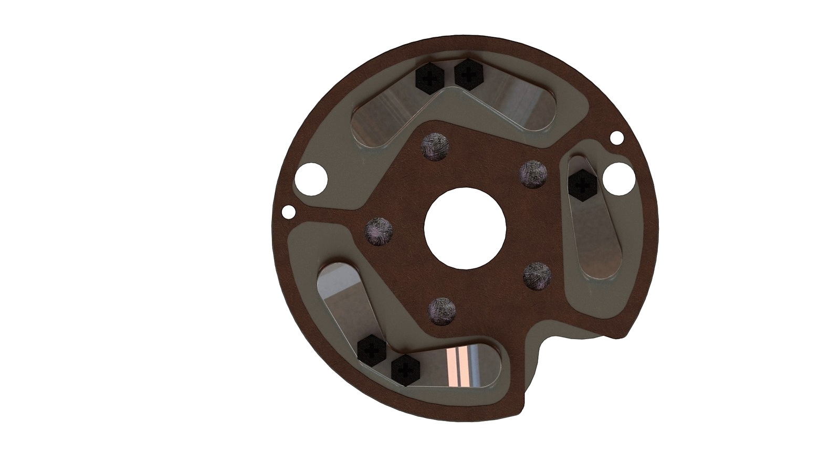
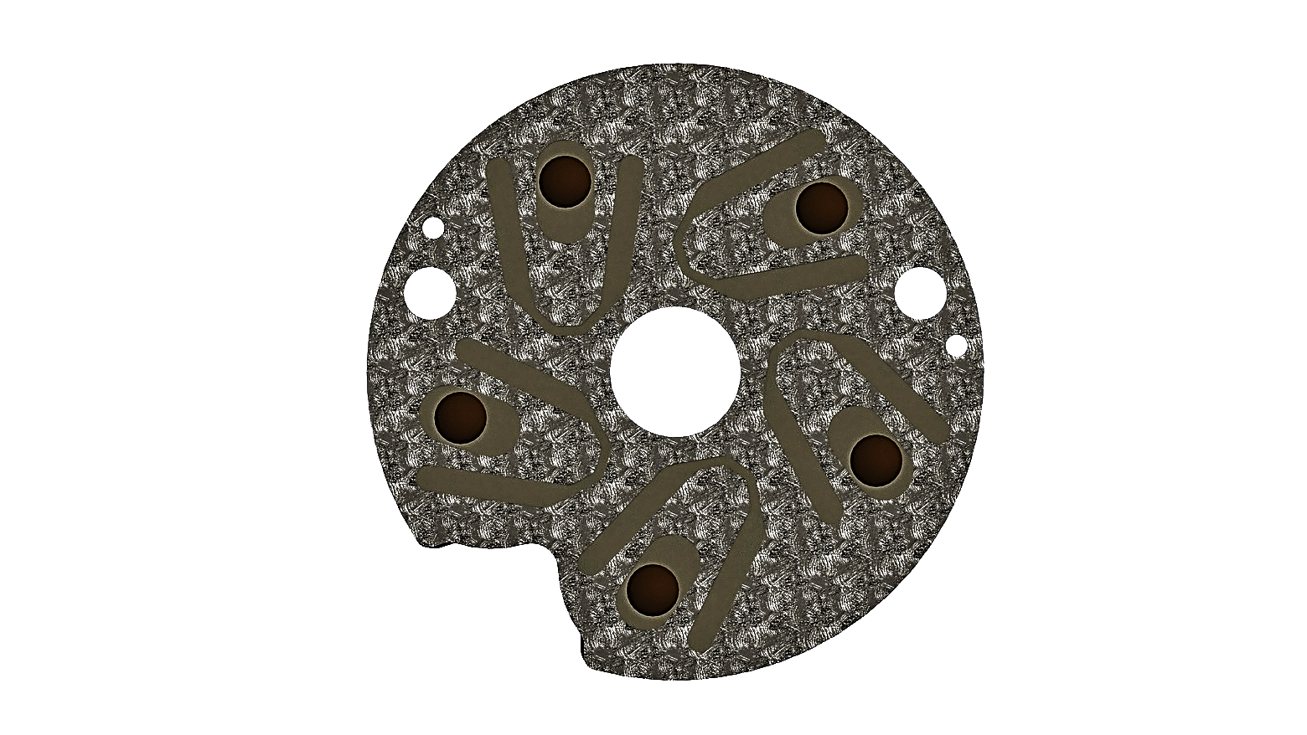
R1234yf maximum burst pressure of
compressor and adjacent cavities
SAE standard J639 -
1200 psi (8.24 mPa)
200 psi (1.38 mPa)
adjacent cavities (low side next to high side) shall be burst tested at maximum pressures
high side must be tested at twice the maximum high side working pressure which is 1200 psi (8.24 mPa) while the low side is maintained at 1.38 mPa
1200 psi (8.24 mPa)
200 psi (1.38 mPa)

Slide 22
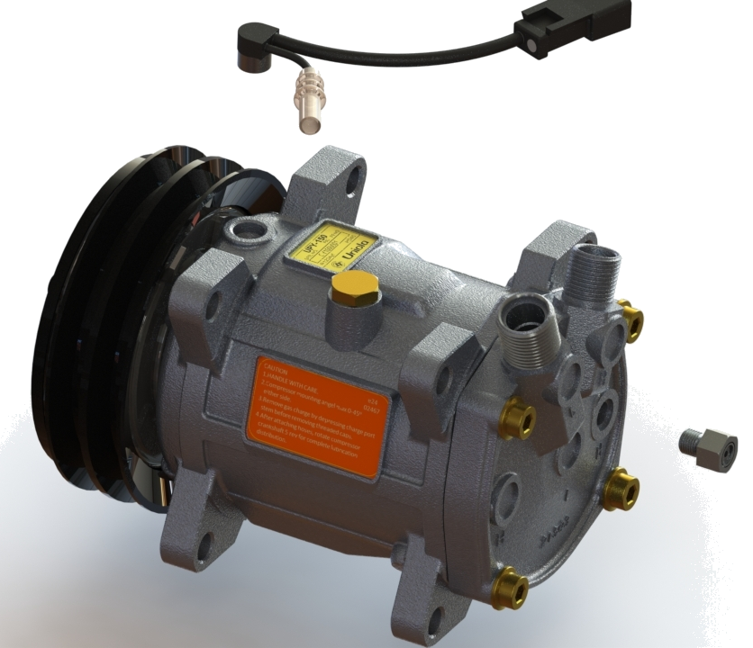
SAE standard J639 - R1234yf compressor design requirements
must be inoperative with no power transmission or power if failed on drawing excessive torque
managed by lock sensor or permanent clutch cutout (designed to eliminate catastrophic failure of compressor components causing refrigerant leakage)
must have pressure relief < 4.14 mPa (600 psig) and self sealing

Slide 23
R1234yf refrigerant line routing and connections
SAE standard J639 -
must be located outside the passenger compartment and outside the cabin airflow path (plenum) – or –
design to sufficiently present no leakage if inside the cabin or cabin air flow path
service manual must state a process to prevent any leakage into cabin or plenum
service fittings must have ease of access for technicians
piping must be sufficiently robust to withstand connect/disconnect procedures
high pressure vapour
high pressure liquid
low pressure liquid
low pressure vapour

Slide 24
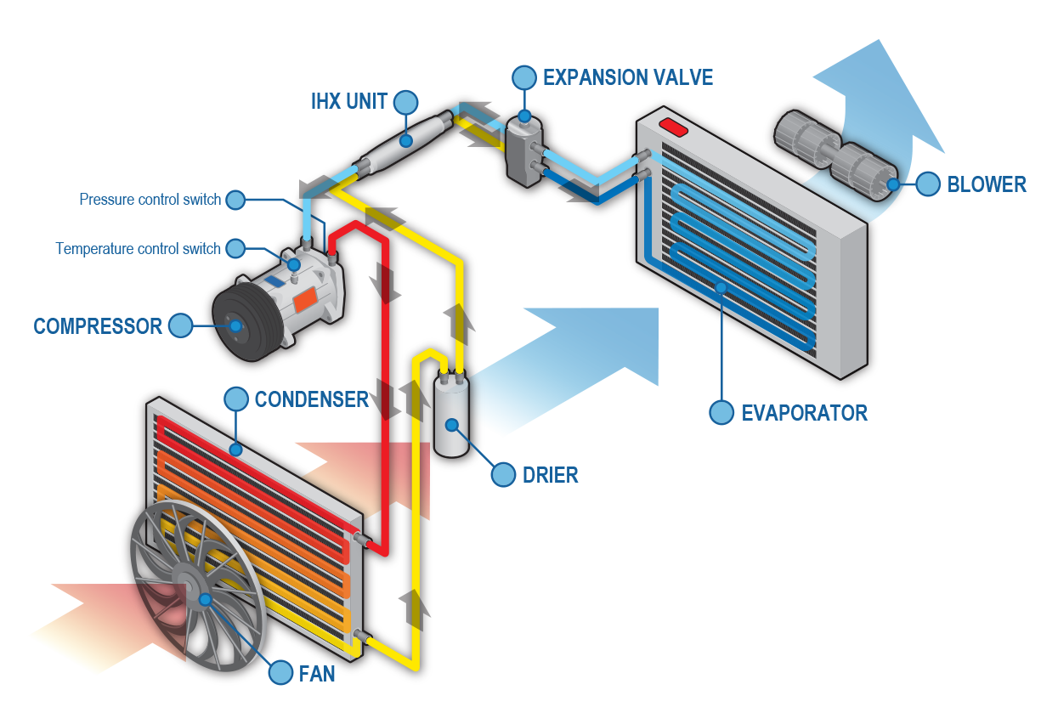
SAE standard J639 - R1234yf compressor design requirements

Slide 25
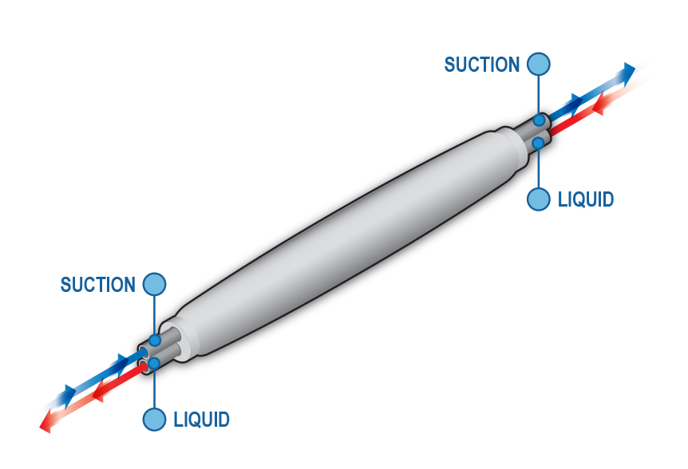
SAE standard J639 - Internal heat exchanger
Internal heat exchanger (IHX)
Defined as a heat exchanger used to transfer heat between the low side pressure and high pressure flow circuits. Its function is to improve system capacity by further sub-cooling the refrigerant being supplied to the evaporator through the refrigerant control device.

Slide 26
SAE standard J639 - internal heat exchanger (IHX)

Slide 27
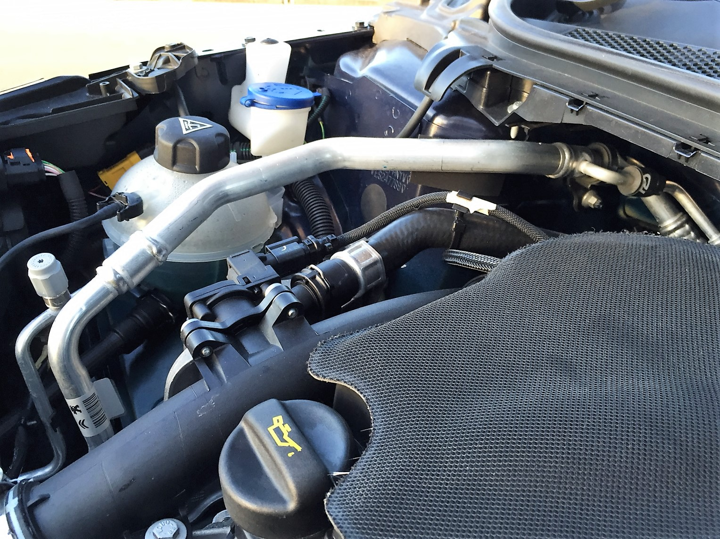
SAE standard J639
internal heat exchanger (IHX)
IHX- not insulated due to no sweating (the temperature never reaches the dew point)
Suction line out (15-20°C)
Liquid line out
Suction line in (5-8°C)
Liquid line in
Peugeot 308 IHX

Slide 28
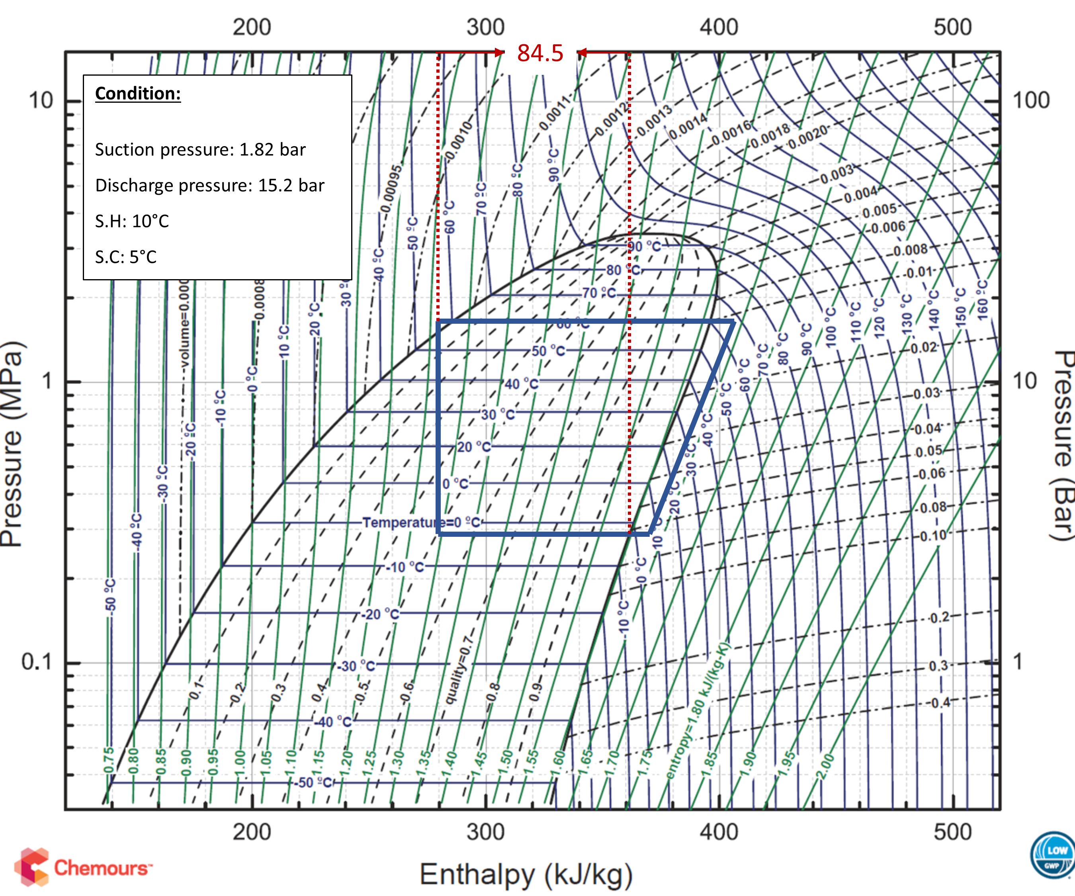
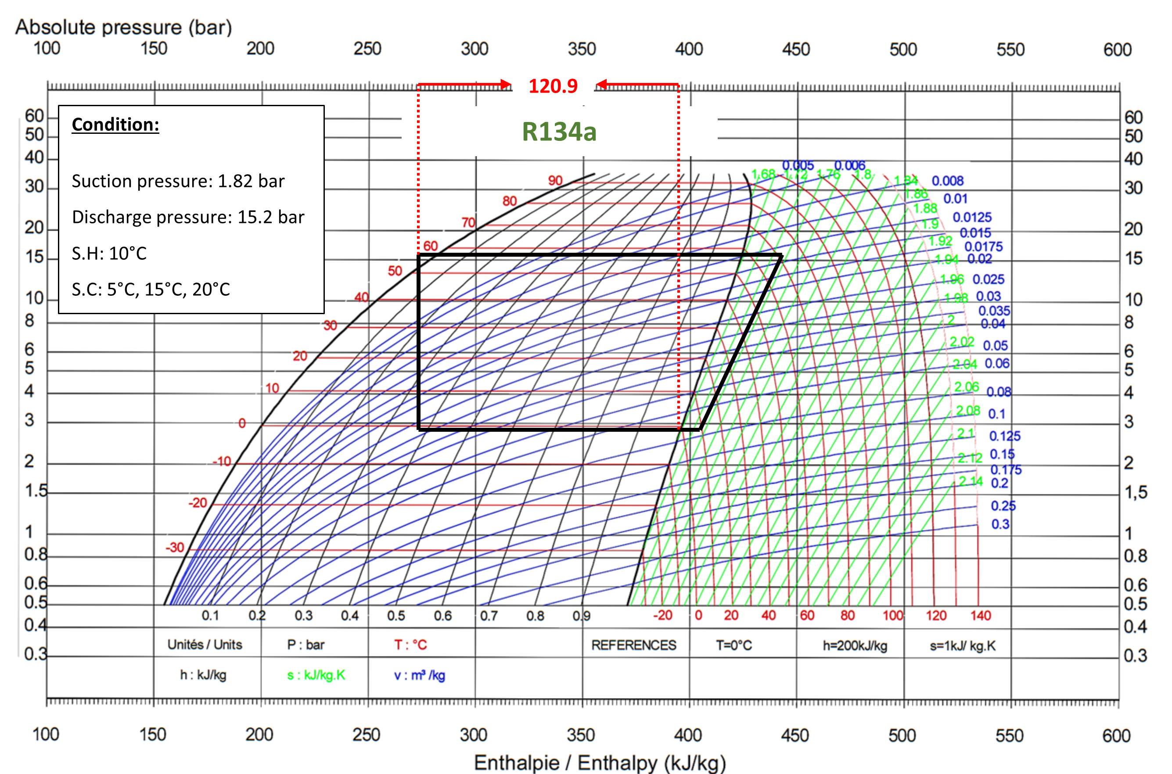
SAE standard J639 - internal heat exchanger (IHX)
R1234yf
R1234yf absorbs slightly less energy per unit of flow in a refrigerant cycle.
R134a absorbs 120.9 kj/kg
R1234yf absorbs 84.5 kj/kg

Slide 29
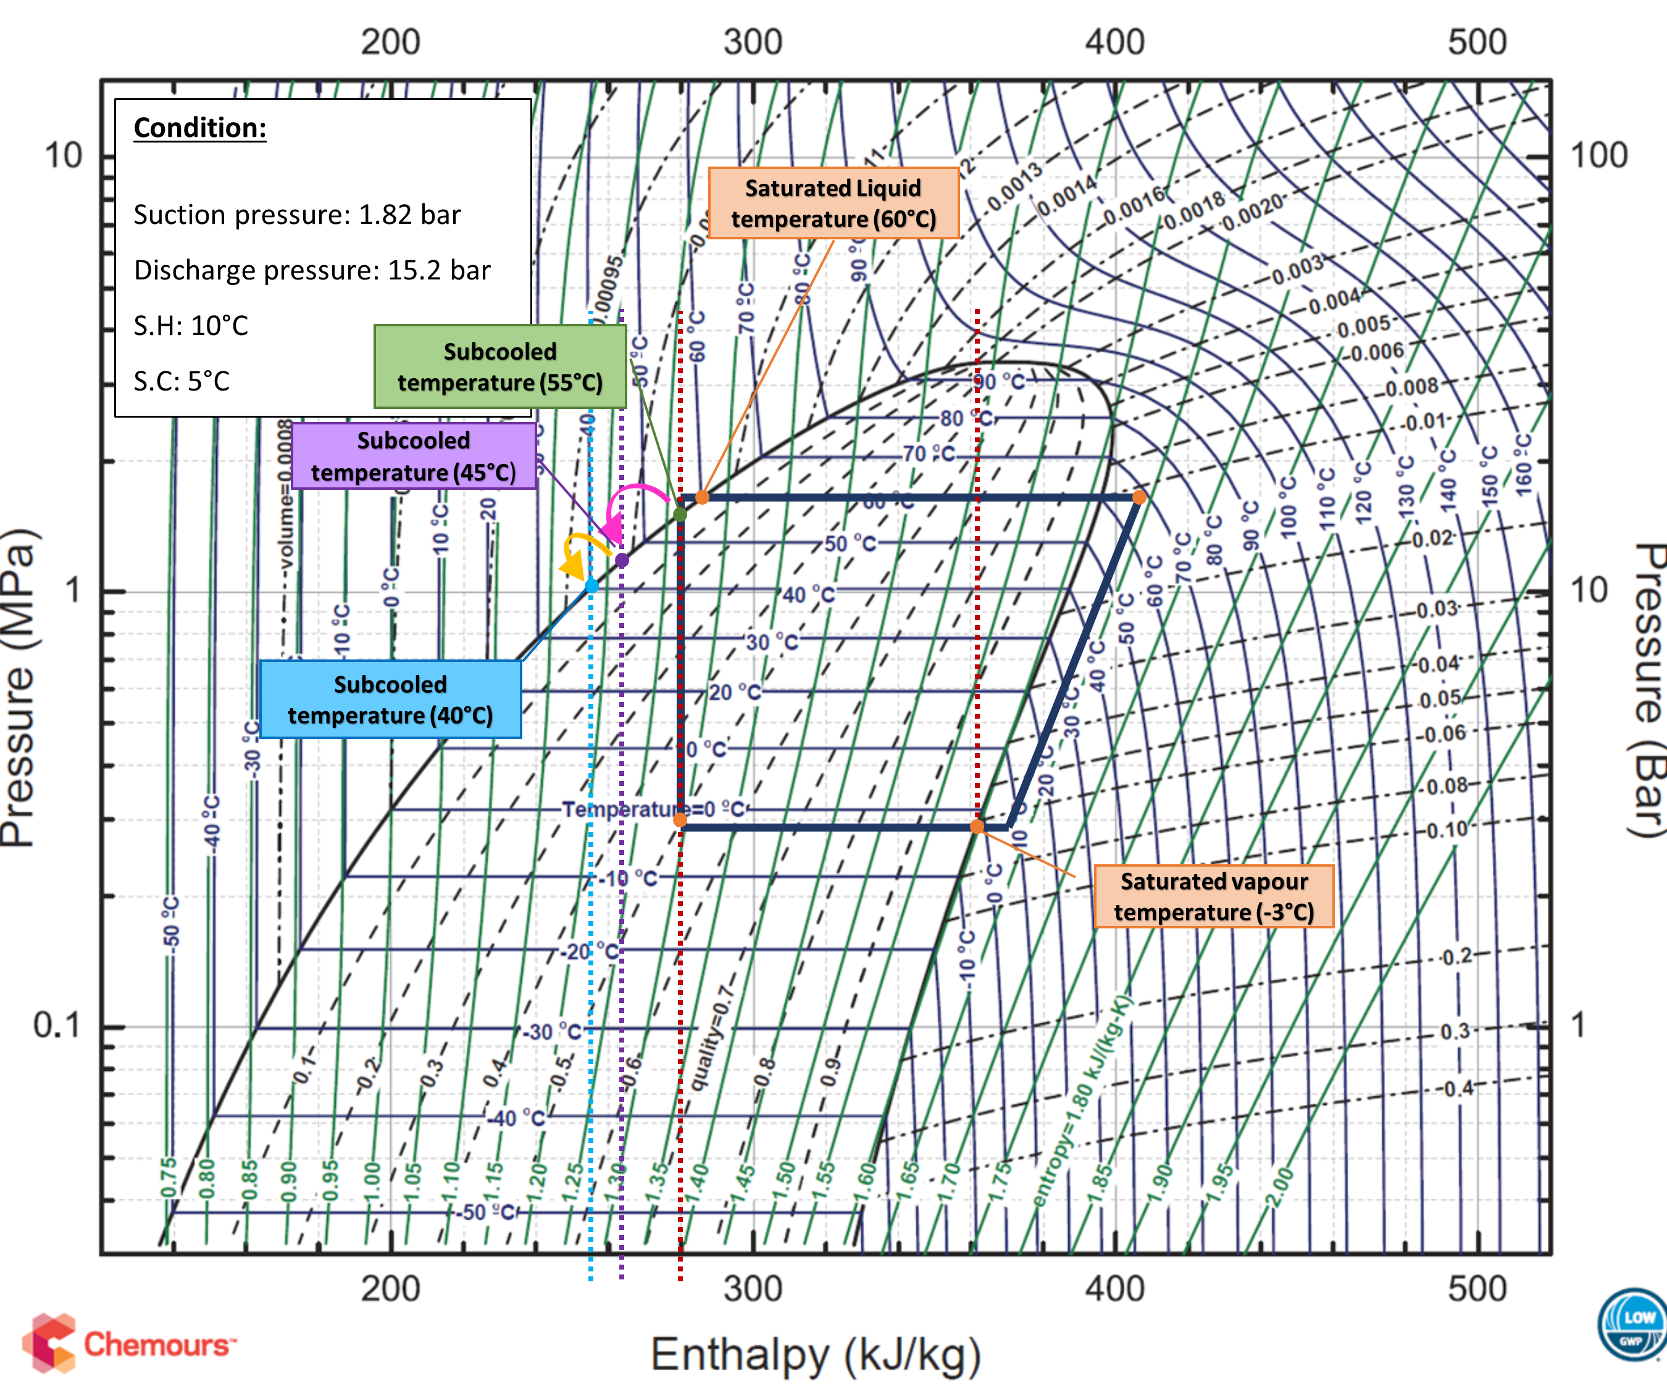
SAE standard J639 - internal heat exchanger (IHX)

Slide 30
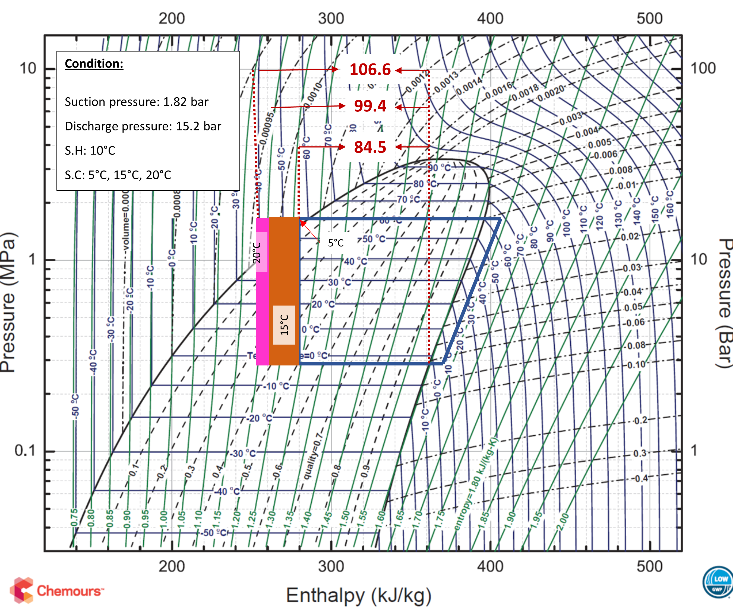
SAE standard J639 - internal heat exchanger (IHX)
With extra subcooling of 10 – R1234yf absorbs 99.4 kj/kg
With extra subcooling of 15 – R1234yf absorbs 106.6 kj/kg

Slide 31
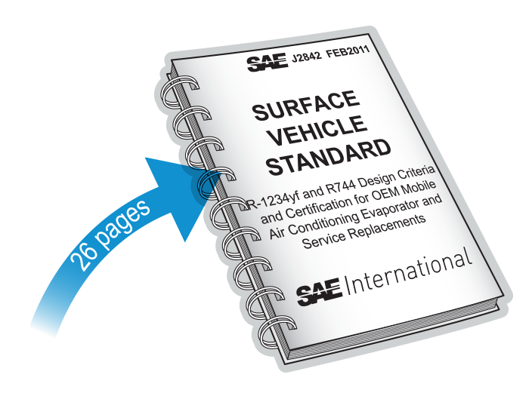
SAE J2842
R1234yf and R744 design criteria and certification for OE mobile air conditioning evaporator and service replacements:
provides a testing framework for evaporator manufacturers to meet J639
describes labelling requirements
demands that all evaporator manufacturers build and test to this standard

Slide 32
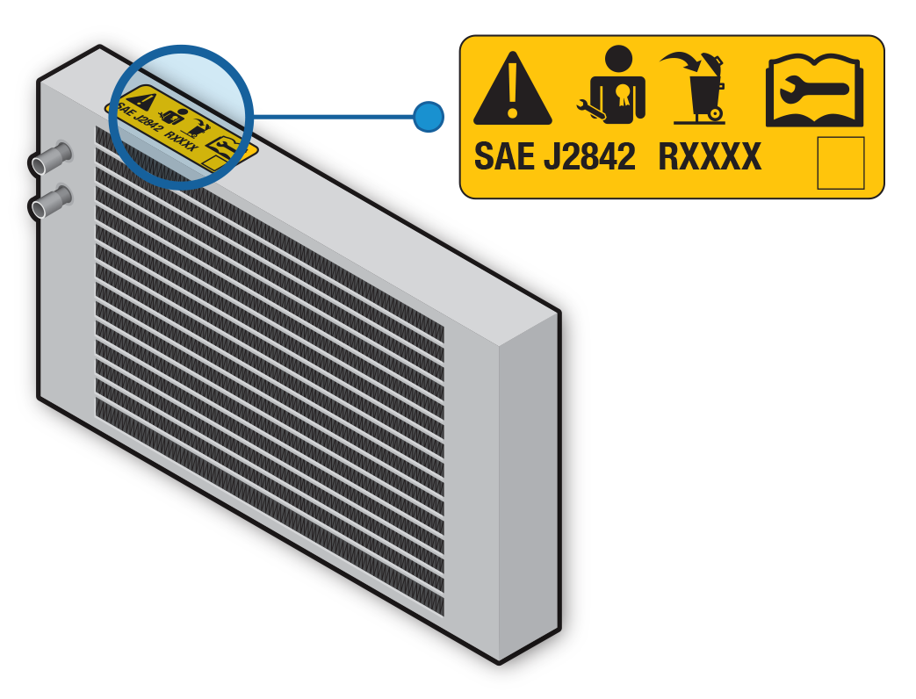
SAE J2842
requirements include standards for strength, corrosion, durability, fatigue resistance, burst pressure and design (2.92 mPa – 423psig)
must be labelled
must meet J639 as one of the MAC components
must never be repaired, re-worked or re-used
must have permanent label, stamp or etching
label must be two colour Pantone orange (151) and black

